Slide 1
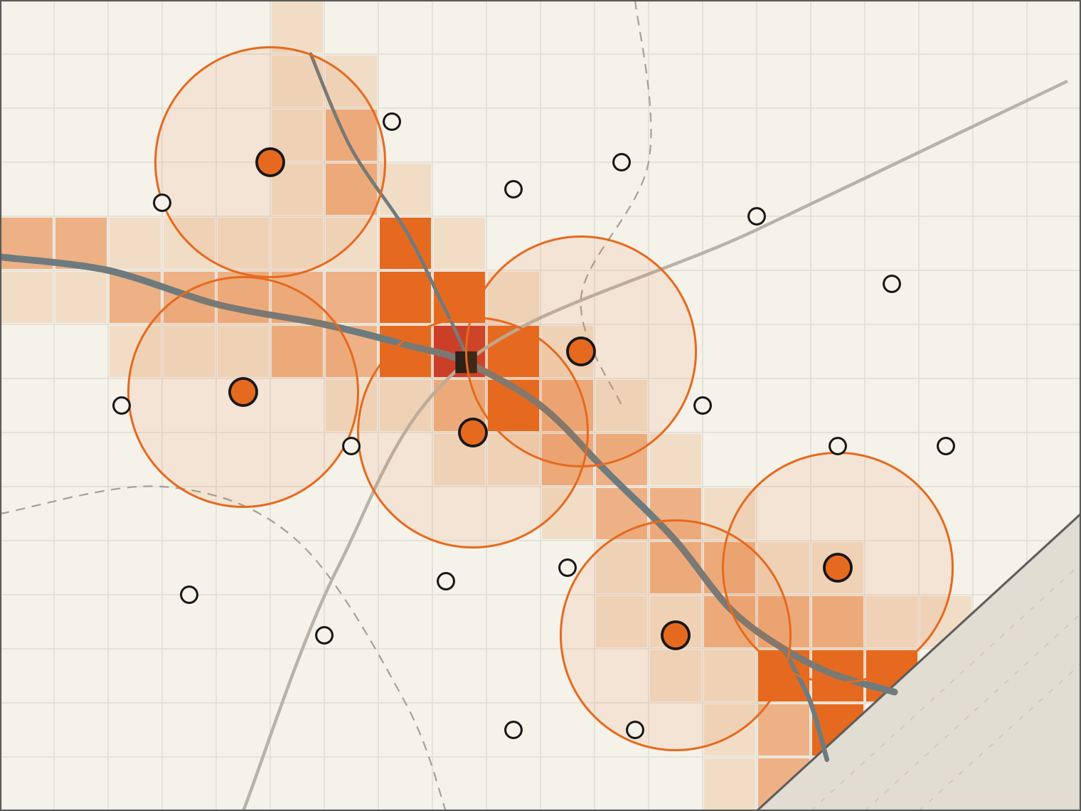
Budameru
QAIC UC-067 · UC-077 · Hybrid quantum-classical
Quantum-Assisted Disaster Response Optimization
Krishna
Vijayawada
Classical ML scores flood risk. QAOA on IBM Quantum decides where sensors and relief go, and re-decides when conditions change.
Bay of Bengal
Team Kala Dhua
Ayush Pathak · Shreeviraj Matale · Tushar Singh
Quantique Hackathon · Amaravati Quantum Valley
Notes:
Open on the map: the Krishna river at Vijayawada, which flooded in September 2024. Coloured cells are the flood-risk layer; orange circles are the six sites chosen by our QAOA pipeline in the benchmark. One-sentence pitch: classical ML says where the risk is, a hybrid quantum-classical optimiser decides where help goes, and the loop re-runs when conditions change. We address QAIC use case UC-067 (flood forecasting and disaster-response sensor placement) and extend to UC-077 (disaster resource and evacuation optimisation).

Slide 2
01 · Problem
Coastal Andhra faced two major disasters in 14 months
Vijayawada floods · Sept 2024
Cyclone Montha · Oct 2025
6.44 lakh
193
₹6,384 cr
people affected
relief camps opened
revised state loss estimate, 24 districts
42,000+
48
43,000 ha
12
people moved to shelters
NDRF + SDRF teams deployed
crops damaged (initial)
NDRF teams in Andhra
Budameru inflow vs diversion canal capacity (cusecs)
~35,000 inflow
7,500 canal capacity · ~4.7× exceeded
Quantum-Assisted Disaster Response Optimization
02 / 15
Notes:
Two events, fourteen months apart, same coast. Vijayawada, September 2024: 6.44 lakh people affected, 193 relief camps, more than 42,000 people moved to shelters, 26 NDRF and 22 SDRF teams deployed (state disaster-management figures as reported by National Herald). The Budameru rivulet carried an estimated 30,000 to 35,000 cusecs into a diversion canal built for about 7,500 (The South First, quoting irrigation experts). Cyclone Montha, October 2025: the state's revised loss estimate to the central team was 6,384 crore rupees across 24 districts (Deccan Herald); All India Radio reported 43,000 hectares of crops damaged initially and 12 NDRF teams positioned in Andhra. Every number here is a placement decision: where camps, teams, boats and sensors go.

Slide 3
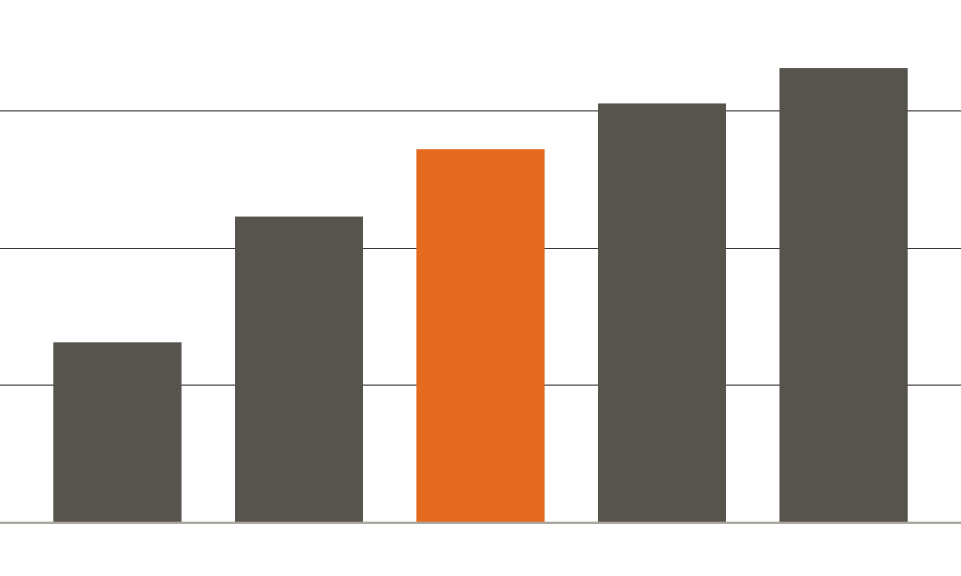
02 · Why it is hard
Placing help is a combinatorial optimization problem
Ways to place 10 units among n candidate sites (log scale)
17 trillion
1.6 trillion
75 billion
848 million
75 billion
185 thousand
plans for 10 teams across 60 sites
Coverage overlaps make sites interdependent
Risk moves as rain and river levels change
A plan made at T0 is stale hours later
Constraint optimization: one binary decision per site → QUBO
n = 20
n = 40
n = 60
n = 80
n = 100
Quantum-Assisted Disaster Response Optimization
03 / 15
Notes:
Placement is subset selection. With 60 candidate sites and 10 teams there are about 75 billion plans (exact binomial coefficient C(60,10)). Sites interact because coverage overlaps, so they cannot be scored independently, and the inputs change during the event. That is precisely the structure of a QUBO: one binary decision variable per site, pairwise terms for overlap, a penalty for the budget constraint. This is why we use quantum optimisation for placement, and classical ML for forecasting.

Slide 4


03 · Research gap
Forecasting is well served; the loop to placement is open
Existing
Our contribution
Flood forecasting
Risk prediction (ML)
Flood Hub · CWC · IMD
Risk prediction
Stops at the forecast
Automatic QUBO construction
Control rooms
Manual placement
Slow; plan is static
District EOCs
QAOA on IBM QPU
Classical optimization
Offline, periodic solve
Not wired to live risk
MILP / heuristics
Constraint validation
Closest prior art: NQCC × Mind Foundry quantum sensor-network PoC (UK, 2025), which covers placement only, with no live risk loop.
Event-triggered re-optimization
The novelty is the closed-loop integration, not a claim of quantum advantage.
Quantum-Assisted Disaster Response Optimization
04 / 15
Notes:
The research gap. Forecasting is crowded and good: Google Flood Hub's model (Nearing et al., Nature 2024), CWC and IMD. Their output is a risk prediction. What happens next is manual in control rooms, or at best a classical MILP solved offline and periodically. The closest quantum prior art is the UK NQCC SparQ project with Mind Foundry on quantum optimisation for disaster sensor networks, which addresses placement but not a live loop from forecast to plan. Our contribution is the chain on the right: risk prediction feeds automatic QUBO construction, QAOA samples placements on IBM hardware, constraints are validated, and the whole loop re-runs when events trigger it. We are explicit: the novelty is the closed-loop integration, not a claim of quantum advantage.

Slide 5

04 · System architecture
Four layers from sensors to field teams
01 · Data sources
02 · Classical services
03 · Quantum layer
04 · Delivery
IMD rainfall grids
Event trigger
Transpiler
Plan store
gridded forecasts, nowcasts
threshold rules on new data
ISA circuit, heavy-hex layout
PostGIS, versioned plans
CWC river gauges
Risk service
Qiskit Runtime
Operator console
stage and discharge
XGBoost, 1 km grid
Sampler V2, batch mode
map, diff vs last plan
Sentinel-1 SAR
QUBO builder
IBM Heron QPU
Field dispatch
past flood extents (labels)
weights, overlaps, k; decompose
4,096 shots per subproblem
SMS / API to teams
SRTM · OSM · Census
Decoder
Audit log
terrain, roads, population
Baseline solver
feasibility check, repair
IBM job IDs, metrics
greedy + exact, fallback
Fallback: if the QPU queue exceeds the response window or no feasible sample returns, the baseline plan ships.
Audit: every plan is stored with its inputs, QUBO, IBM job ID and hardware metrics.
Quantum-Assisted Disaster Response Optimization
05 / 15
Notes:
System architecture in four layers. Data sources: IMD rainfall grids, CWC river gauges, Sentinel-1 radar for past flood extents used as training labels, and SRTM terrain, OpenStreetMap roads and Census population. Classical services: an event trigger that fires on threshold crossings, the risk service, the QUBO builder that also decomposes the region, and a classical baseline solver. Quantum layer: Qiskit transpiles to ISA circuits for the heavy-hex lattice, Qiskit Runtime's Sampler V2 submits in batch mode, the IBM Heron QPU samples, and a decoder checks feasibility and repairs if needed. Delivery: a versioned plan store, the operator console, dispatch to field teams, and an audit log. Two engineering decisions researchers should note: the classical baseline is always computed and ships if the QPU cannot answer in time, and every plan is traceable to an IBM job ID.

Slide 6
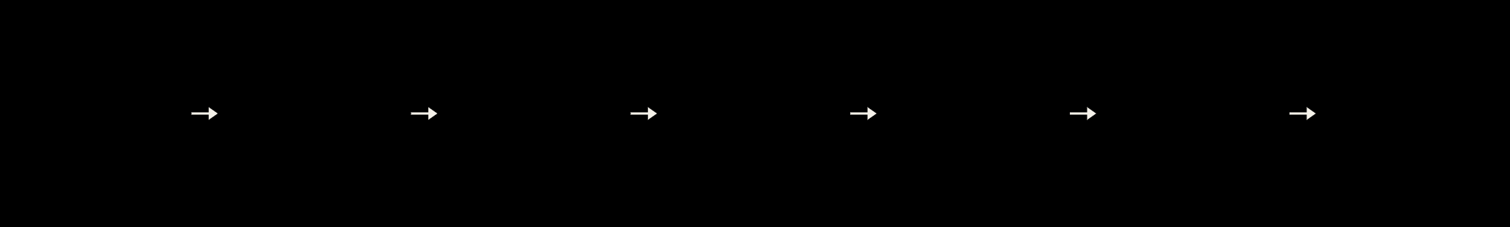
05 · Method
One pipeline from risk map to deployed plan
Quantum stages
01
02
03
04
05
06
07
Disaster map
Risk model
QUBO
QAOA circuit
IBM QPU
Placement
Adaptation
IMD · SRTM · OSM
XGBoost classifier
Qiskit, Ising form
Qiskit, p = 1–2
Heron · Runtime
Decoded bitstring
Event trigger
Re-run when rainfall, river level or road status crosses a threshold
Classical where classical is strong: forecasting. Quantum where the problem is combinatorial: choosing sites.
Quantum-Assisted Disaster Response Optimization
06 / 15
Notes:
The method as one line. 01: gridded disaster map from IMD rainfall, SRTM elevation and OpenStreetMap. 02: gradient-boosted risk model. 03: the placement decision becomes a QUBO, converted to an Ising Hamiltonian. 04: Qiskit builds the QAOA circuit with one or two layers. 05: the circuit runs on an IBM Heron QPU through Qiskit Runtime. 06: the best feasible bitstring decodes into a placement. 07: when inputs cross a threshold, the loop re-runs from the risk model. Only the three boxed stages are quantum; that split is deliberate.

Slide 7
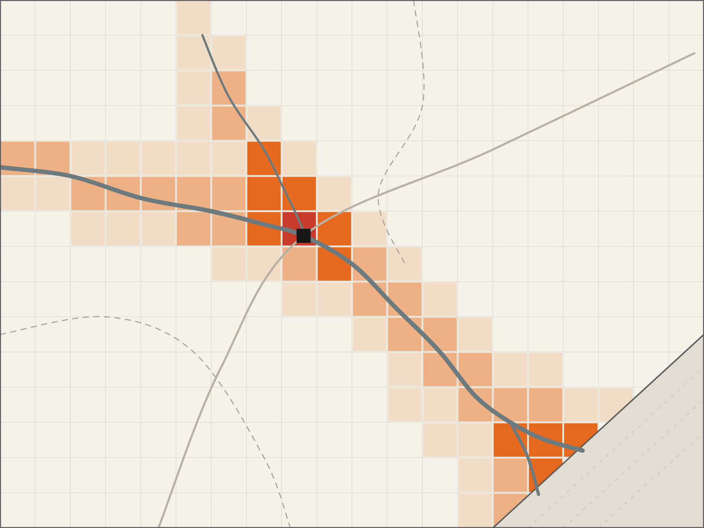
06 · Stage 1 — classical ML
A risk score for every grid cell
Features: IMD gridded rainfall, SRTM elevation, river distance, land use
Labels: Sentinel-1 SAR flood extents from past events, incl. Sept 2024
Model: gradient-boosted trees (XGBoost), 1 km cells, spatial cross-validation
Output: risk × exposure = weight w_i for each candidate site
Vijayawada
Low
Moderate
High
Severe
Shown: the prototype risk layer (river-distance and low-lying-terrain features) used in the benchmark.
Bay of Bengal
Quantum-Assisted Disaster Response Optimization
07 / 15
Notes:
Stage one is deliberately classical: gradient-boosted trees are strong on tabular geospatial data and fast to retrain. Features are IMD gridded rainfall, SRTM elevation, distance to river and land use; labels are flood extents mapped from Sentinel-1 radar for past events including September 2024; validation is spatial cross-validation so neighbouring cells do not leak. The only thing the optimiser needs from this stage is a weight per candidate site: risk times exposure within that site's coverage radius. The map shown is the prototype risk layer we used for the benchmark, built from river-distance and low-lying-terrain features; the trained model plugs into the same interface.

Slide 8
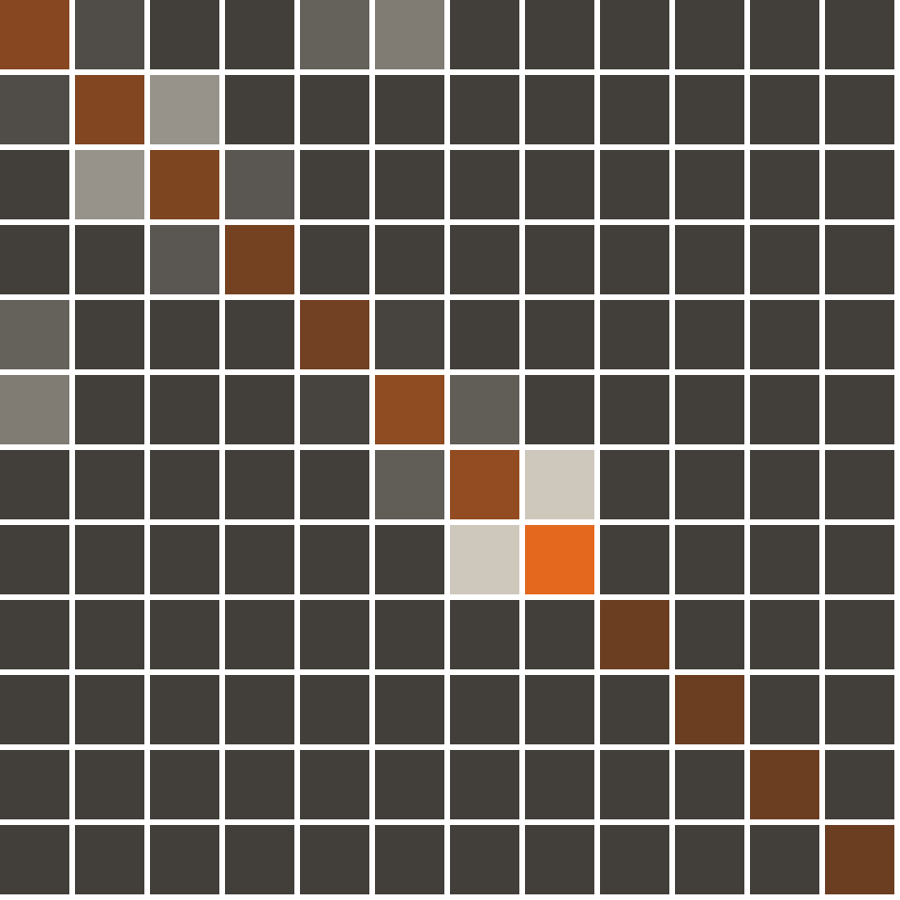
07 · Stage 2 — formulation
Each site: one binary variable, one problem qubit
min f(x) = − Σ w_i·x_i
+ Σ o_ij·x_i·x_j
+ λ (Σ x_i − k)²
x_i ∈ {0,1} · x_i = (1 − z_i)/2 → Ising Hamiltonian H_C
w_i risk-weighted exposure site i covers
o_ij coverage overlap between sites i and j
λ = 0.6 · max w_i enforces exactly k units
Every QUBO checked against exhaustive search
Actual QUBO of the 12-qubit western subproblem
Reward
Penalty
Quantum-Assisted Disaster Response Optimization
08 / 15
Notes:
Stage two. Each candidate site is one binary decision variable, which in this formulation maps to one problem qubit. The objective rewards risk-weighted exposure covered, penalises overlap between two chosen sites, and a quadratic penalty with lambda equal to 0.6 times the largest site weight enforces exactly k units. Substituting x = (1 - z)/2 gives the Ising Hamiltonian that QAOA minimises; we verified numerically that the Ising form reproduces every QUBO energy up to a constant. The heat map is the actual 12 by 12 QUBO of the western subproblem in our benchmark. Note it is dense: the cardinality penalty couples every pair, which matters for hardware routing on the next slides.

Slide 9
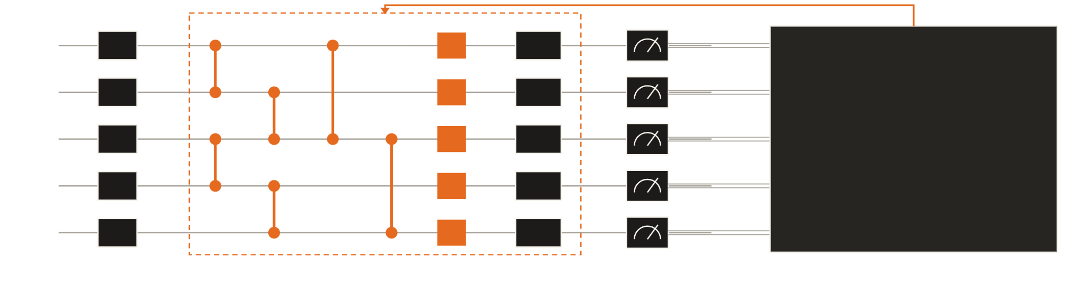
08 · Stage 3 — Quantum Approximate Optimization Algorithm
QAOA: quantum sampling, classical tuning
× p layers, p = 1–2
q0
q1
Classical optimiser
COBYLA minimises CVaR(α = 0.2) of sampled QUBO energy; returns new γ, β
q2
q3
q4
Hadamard
Cost e^(−iγH_C)
Mixer e^(−iβH_B)
Measure
Classical outer loop → quantum sampling → CVaR energy evaluation → parameter update
Cost layer encodes the QUBO: ZZ for overlaps, Z for rewards
Mixer moves amplitude between placements
Warm start reuses γ, β from the last run when inputs change
Quantum-Assisted Disaster Response Optimization
09 / 15
Notes:
Stage three: the Quantum Approximate Optimization Algorithm on a parameterized quantum circuit. Start in equal superposition; the cost layer applies ZZ rotations for overlaps and Z rotations for site rewards; the mixer applies X rotations so amplitude can move between placements; repeat p times with p equal to 1 or 2 because deeper circuits are noise-limited on NISQ hardware. The loop is explicit: a classical outer loop proposes angles, the quantum device samples bitstrings, we evaluate the conditional value-at-risk of the sampled QUBO energies with alpha 0.2 (Barkoutsos et al., Quantum 2020), and COBYLA updates the angles. For adaptation we warm-start from the previous angles (Egger et al., Quantum 2021).

Slide 10
09 · Execution
Hybrid execution on IBM Quantum under NISQ noise
01
Qiskit
≤20
QUBO → Ising operator, QAOAAnsatz
Decompose
logical problem qubits per subproblem; target hardware: IBM Heron class
02
Region → ≤20-qubit subproblems (ours: 12 + 11)
Transpile
66
03
ISA circuit, heavy-hex, optimization level 3
ZZ terms per QAOA layer in our 12-qubit subproblem: the k-constraint makes it dense
04
Qiskit Runtime
Sampler V2, batch mode (Open Plan)
IBM Heron QPU
20,000+
05
Simulator-optimised angles, 4,096 shots
2-qubit gates when large QAOA is transpiled naively; noise-dominated (arXiv 2607.11637)
06
Mitigate & decode
Dynamical decoupling, Pauli twirling, CVaR
Hardware-aware decomposition: problem size is set by measured circuit fidelity, not nominal qubit count.
Quantum-Assisted Disaster Response Optimization
10 / 15
Notes:
How the quantum stage runs. Qiskit converts the QUBO to an Ising operator and builds a QAOAAnsatz. We decompose the region into subproblems of at most about 20 logical problem qubits; in the benchmark they are 12 and 11. The reason: a July 2026 benchmark on IBM Heron found naive QAOA on larger instances transpiling to more than 20,000 two-qubit gates with results indistinguishable from random. Our own subproblem is dense, 66 ZZ terms per layer, because the cardinality penalty couples every pair, so routing on heavy-hex adds SWAPs; that is why size is set by fidelity, not by the 133 to 156 physical qubits on the chip. Circuits are transpiled at optimisation level 3, submitted through Qiskit Runtime Sampler V2 in batch mode, which the free Open Plan supports, with angles optimised on the simulator and transferred, 4,096 shots per subproblem, dynamical decoupling and gate twirling on. The same code targets the planned Amaravati IBM Quantum System Two environment.

Slide 11
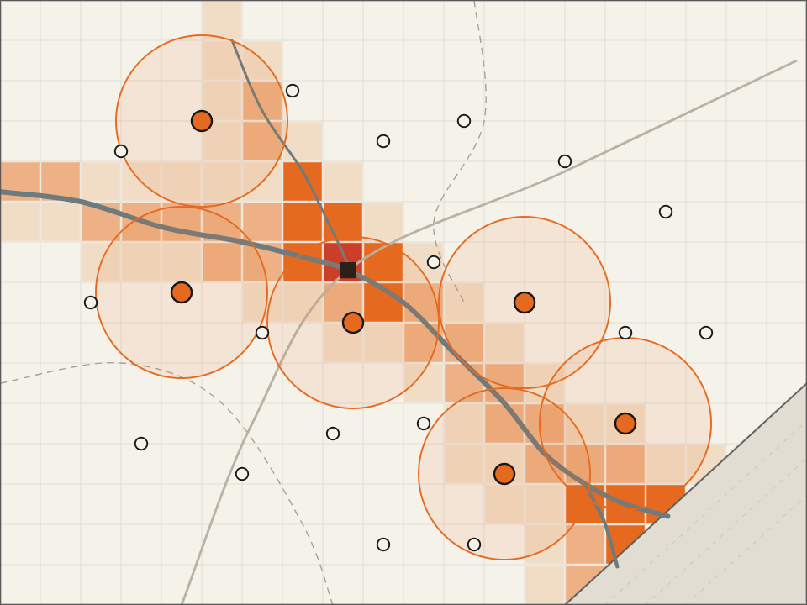
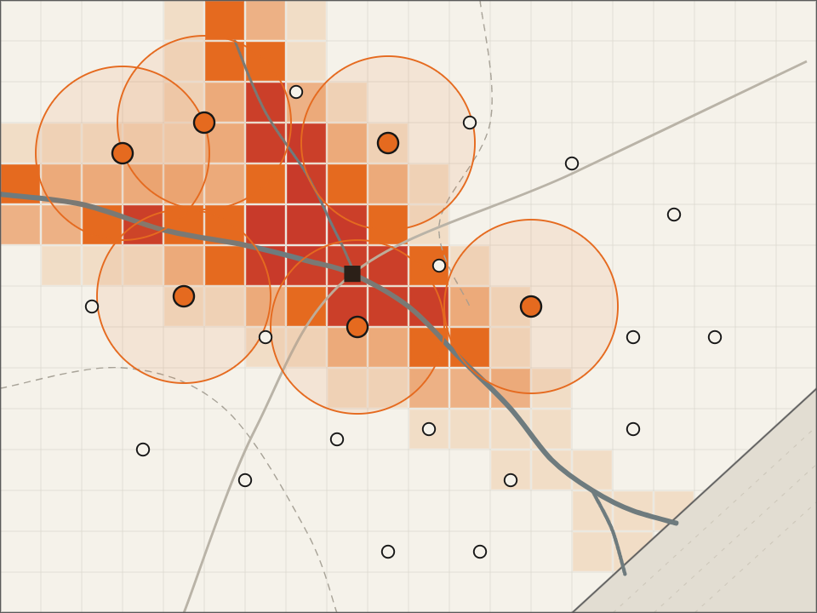
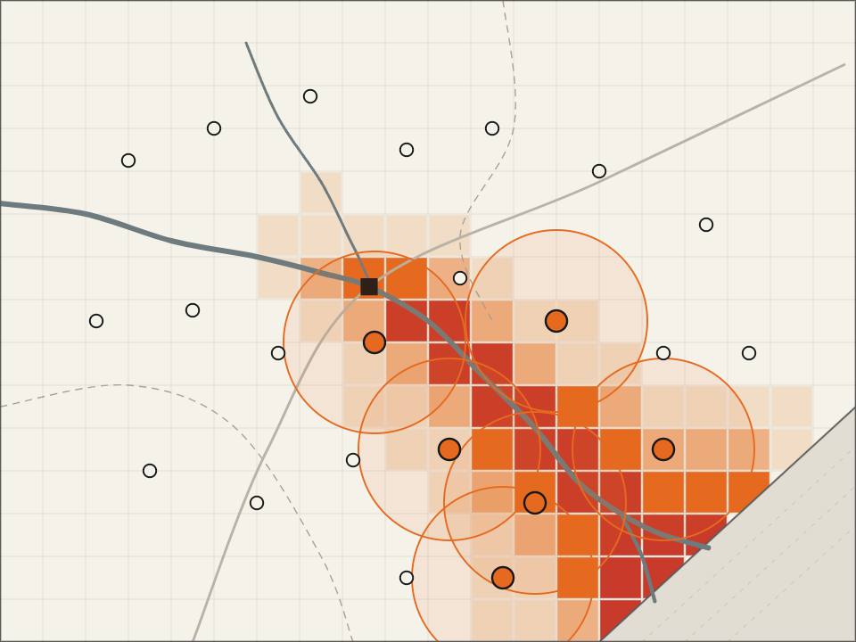
10 · Adaptation
A closed loop that re-solves only the affected region
T0 · forecast issued
T+6 h · Budameru surge
T+12 h · delta flooding
Baseline risk; initial solve
Risk shifts north; re-solved
Delta at risk; re-solved
Trigger: new rainfall, gauge or road data past a threshold
Local re-solve: only subregions whose risk changed go back to the QPU
Warm start: previous γ, β cut optimiser iterations
Quantum-Assisted Disaster Response Optimization
11 / 15
Notes:
This is our main innovation: a closed-loop quantum optimisation system that re-solves only the affected region when disaster conditions change. At T0 the forecast gives a baseline and we place six units. Six hours later the Budameru catchment surges, the risk layer shifts north, and units move toward it. By T plus 12 hours the water is in the delta and the plan follows. Three mechanisms keep QPU time small: an event trigger so we re-run only when inputs change; local re-solving so only affected subregions return to the hardware; and warm-starting from the previous QAOA angles. The three maps are the same pipeline applied to three risk states of our prototype risk layer.

Slide 12
11 · Benchmark
QAOA reaches 95% of optimum on our instance
Risk-weighted coverage, same instance, k = 6 units
QAOA subproblem | West | East
Problem qubits | 12 | 11
Units k | 3 | 3
ZZ terms / layer | 66 | 55
Feasible samples | 41.8% | 45.8%
Random baseline | 5.4% | 8.1%
Hit QUBO optimum | Yes | Yes
Uniform spacing
static plan
21.8% · ratio 0.35
Greedy heuristic
0.01 s
61.9% · ratio 1.00
Exact search
100,947 plans · 0.7 s
61.9% · ratio 1.00
QAOA p=2, ideal sim
2 subproblems · 9.4 s
58.9% · ratio 0.95
QAOA raises feasible plans 7.8× and 5.7× over random sampling
The 5% gap comes from the pairwise QUBO and regional split, not the sampler
Greedy is optimal here: no quantum advantage claimed
Krishna-basin grid · 285 cells · 23 sites
Hardware step: the same circuits run on IBM Heron via benchmark/run_ibm.py (transferred angles, 4,096 shots, job IDs logged).
Quantum-Assisted Disaster Response Optimization
12 / 15
Notes:
The evidence slide. One synthetic instance on the Krishna-basin grid: 285 cells, 23 candidate sites, 6 units, 100,947 possible plans. Four methods on the same instance and the same objective, risk-weighted coverage. Uniform spacing, a static plan, covers 21.8%. Greedy covers 61.9%, which equals the exact optimum found by exhaustive search in 0.7 seconds. QAOA with p equal to 2, simulated ideally, decomposed into a 12-qubit and an 11-qubit subproblem, reaches 58.9%, an approximation ratio of 0.95. Inside each subproblem QAOA found the exact QUBO optimum, and it concentrated 41.8% and 45.8% of samples on feasible plans versus 5.4% and 8.1% for random sampling. So the remaining gap is from modelling choices, the second-order QUBO and the regional split, not from the quantum sampler. Greedy is already optimal here, so we claim no quantum advantage; the point is a validated, hardware-ready pipeline. The hardware step runs the same circuits on IBM Heron with run_ibm.py.

Slide 13

12 · Demo
The operator view: a map, a QPU job, a plan
Q-ADR console · Krishna basin
● Qiskit Runtime ready
Quantum job
Event
T0 · forecast issued
Solver
QAOA p = 2 · 2 subproblems
Problem qubits
12 + 11
Shots
4,096 per subproblem
Feasible samples
41.8% / 45.8%
Status
Plan ready
6 units placed · 58.9% risk-weighted coverage
1
Load live event
2
Score risk
3
Solve on the QPU
4
Re-plan on update
Quantum-Assisted Disaster Response Optimization
13 / 15
Notes:
The screen the video walks through, filled with the benchmark run. Left: risk layer and the six sites QAOA chose. Right: the quantum job: two subproblems of 12 and 11 problem qubits, 4,096 shots each, 41.8 and 45.8 percent feasible samples, plan ready. The four steps at the bottom are the video script: load an event, score risk, solve, then inject a change and show the re-plan. When recording, show the IBM Quantum Platform job page next to the console so the job IDs are visible.

Slide 14
13 · Contribution and limits
A quantum-compatible, hardware-executed pipeline
What is new
Fit to QAIC
Honest limits
Closed loop: ML risk → QUBO → QAOA, no manual step
Event-triggered, warm-started, local re-solve
Decomposition sized to measured QPU fidelity
Addresses UC-067; extends to UC-077
Builds on DST-NQM proposals 03 and 04
Compatible with the planned Amaravati IBM Quantum System Two
No quantum advantage claimed at this scale
NISQ noise caps subproblems near 20 qubits
Greedy and exact solvers stay baseline and fallback
Done
Now
Next
Proposed
Pipeline + benchmark vs greedy and exact
Same circuits on IBM Heron via Qiskit Runtime
Train XGBoost on Sentinel-1 flood extents
APSDMA pilot; cyclones (UC-077)
Buyer: state disaster authorities; ₹2.29 lakh crore in disaster funds for 2021–26 (15th Finance Commission, PIB).
Quantum-Assisted Disaster Response Optimization
14 / 15
Notes:
Positioning, stated plainly: we demonstrate a quantum-compatible, hardware-executed optimisation pipeline, not practical quantum advantage on today's small instances. What is new: the closed loop from ML risk to QUBO to QAOA with no manual step; event-triggered, warm-started, local re-solving; and decomposition sized to measured hardware fidelity. Fit: UC-067 directly, extending to UC-077; it builds on DST-NQM proposals 03 (quantum optimisation for mobility and logistics, IIT Hyderabad and IISER Tirupati) and 04 (QUEST climate modelling, with Andhra University); and it is designed for compatibility with the planned Amaravati IBM Quantum System Two environment. Limits: no advantage claimed; subproblems capped near 20 qubits by noise; classical solvers remain baseline and fallback. The buyer is the state disaster authority, funded through the 15th Finance Commission's 2.29 lakh crore disaster allocation.

Slide 15
14 · Summary
References
Methods
Forecasts say where the water goes. We decide where help goes.
1. Farhi, Goldstone, Gutmann (2014). QAOA. arXiv:1411.4028
2. Lucas (2014). Ising formulations of NP problems. Front. Phys. 2:5
3. Barkoutsos et al. (2020). CVaR variational optimization. Quantum 4:256
4. Egger, Mareček, Woerner (2021). Warm-starting QAOA. Quantum 5:479
5. QAOA benchmarks on IBM Heron (2026). arXiv:2607.11637
ML risk → QUBO → QAOA → plan, re-solved as the flood moves
Benchmarked against greedy and exact baselines
Portable to larger local QPU capacity as it becomes available
6. Nearing et al. (2024). Global flood prediction. Nature 627:559
Platform and programme
7. IBM Quantum docs: Heron, Qiskit Runtime, Open Plan
8. IBM Newsroom (2 May 2025): Amaravati Quantum Valley
9. NQCC SparQ (2025): Mind Foundry sensor-network PoC
10. QAIC (2026): 100 Quantum Use Cases, UC-067, UC-077
Demo video:
Problem data
Demo link:
11. PIB / MHA: 15th Finance Commission disaster funds
Code: github.com/officialayush23/QuantumHack
12. All India Radio (Oct 2025): Cyclone Montha
Kala Dhua · officialayushp123@gmail.com
13. Deccan Herald: Montha loss ₹6,384 cr, 24 districts
14. National Herald (Sept 2024): Vijayawada state figures
15. The South First: Budameru inflow vs canal capacity
Quantum-Assisted Disaster Response Optimization
15 / 15
Notes:
Close on the one-line idea: forecasts tell you where the water goes; our system decides where help goes, on quantum hardware, and keeps deciding as the situation changes. Point to the demo video and the repository, which includes the benchmark (qadr_bench.py) and the hardware runner (run_ibm.py). References are grouped: methods first, then platform, then problem data.

